Slide 1


COSC 2436
Data Structures and Algorithms
WORKSHOP
Spring 2024
dcarril9@cougarnet.uh.edu
ykhan5@cougarnet.uh.edu

Slide 2
contents
Exam 1 Overview
Topic Practice Problems
Last Minute Questions
dcarril9@cougarnet.uh.edu
ykhan5@cougarnet.uh.edu

Slide 3
Exam Outline
Linked Lists (4 Questions → 39 Points)
Recursion (2 Questions → 22 Points)
Sorting (3 Questions → 19 Points)
Arrays (1 Question → 8 Points)
Time Complexity (2 Questions → 12 Points)

Slide 4
Exam Tips
If you don’t know the answer to a question immediately… MOVE ON
Don’t waste precious time when you could be working on other questions
You want to rack up as many points as you can
Partial credit is your best friend
Even if you don’t have the exact answer in mind, anything can be better than writing absolutely nothing
Ex. Recursion → At least write down a base case
Go over Extras/Workshop Examples
These questions have a chance of showing up on the exam in some capacity
Start studying now if you haven’t
I do not recommend cramming for any DSA exam

Slide 5
MOCK EXAM SOLUTIONS
dcarril9@cougarnet.uh.edu
ykhan5@cougarnet.uh.edu

Slide 6
Problem - findMiddle()
1. Write a function called findMiddle() which finds the middle of a linked list. You may only use one for loop or while loop to do so.
struct node{
int value;
node *next;
node(int v) : value(v), next(nullptr) {}
};
node* findMiddle() {}
dcarril9@cougarnet.uh.edu
ykhan5@cougarnet.uh.edu

Slide 7
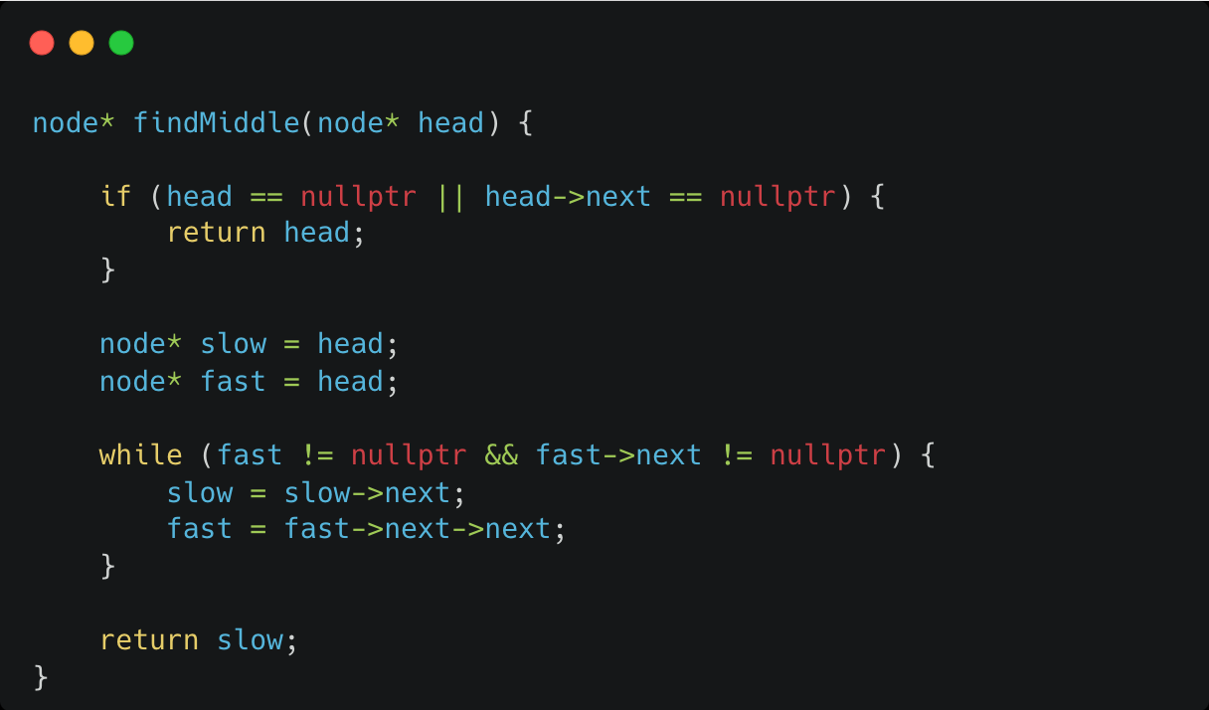
dcarril9@cougarnet.uh.edu
ykhan5@cougarnet.uh.edu

Slide 8
Problem - removeSmallest()
2. Write the function node* removeSmallest() which removes the smallest value in a doubly linked list.
node *removeSmallest(12 ⇄ 26 ⇄ 4 ⇄ 2 ⇄ 78) => 12 ⇄ 26 ⇄ 4 ⇄ 78
struct node{
int value;
node *next;
node* prev;
node(int v) : value(v), next(nullptr) {}
};
node *removeSmallest(node* head) {}
dcarril9@cougarnet.uh.edu
ykhan5@cougarnet.uh.edu

Slide 9
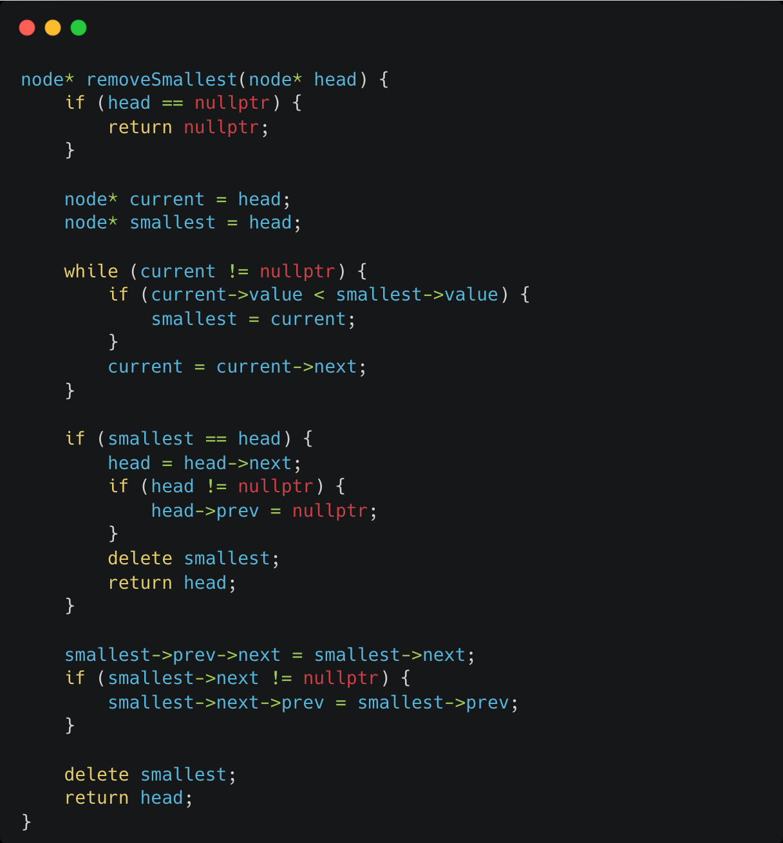
Solution
dcarril9@cougarnet.uh.edu
ykhan5@cougarnet.uh.edu

Slide 10
Problem - numRotations()
3. Write a function which calculates how many times a sorted singly linked list has been rotated around.
List: 4 → 5 → 1 → 2 → 3
Output: 2
int numRotations(4 → 5 → 1 → 2 → 3) => 2
struct node{
int value;
node *next;
node(int v) : value(v), next(nullptr) {}
};
int numRotations(node *head){ }
dcarril9@cougarnet.uh.edu
ykhan5@cougarnet.uh.edu

Slide 11
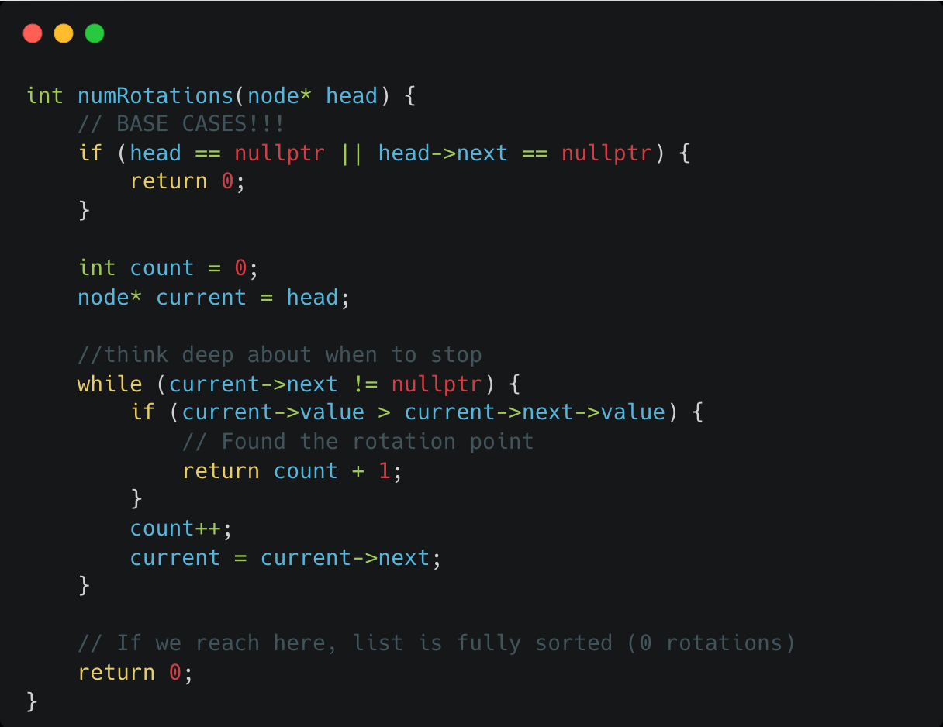
Solution
dcarril9@cougarnet.uh.edu
ykhan5@cougarnet.uh.edu

Slide 12
Problem - Merge Sorted list
4. You are given two linked lists of equal size which first have even numbers, then odd numbers, merge them so that the resulting list is as follows : even numbers in order - odd numbers in order. Return the head of the resulting linked list.
List 1: 2 → 6 → 10 → 3 → 7 → 9
List 2: 4 → 8 → 12 → 1 → 13 → 15 → 19
Output: 2 → 4 → 6 → 8 → 10 → 12 → 1 → 3 → 7 → 9 → 13 → 15 → 19
node *mergeWithPattern(node* head) {}
What’s most important from this question is pointer management with two lists and a third creation list. The next page will have the regular merge sorted lists question solution.
dcarril9@cougarnet.uh.edu
ykhan5@cougarnet.uh.edu

Slide 13
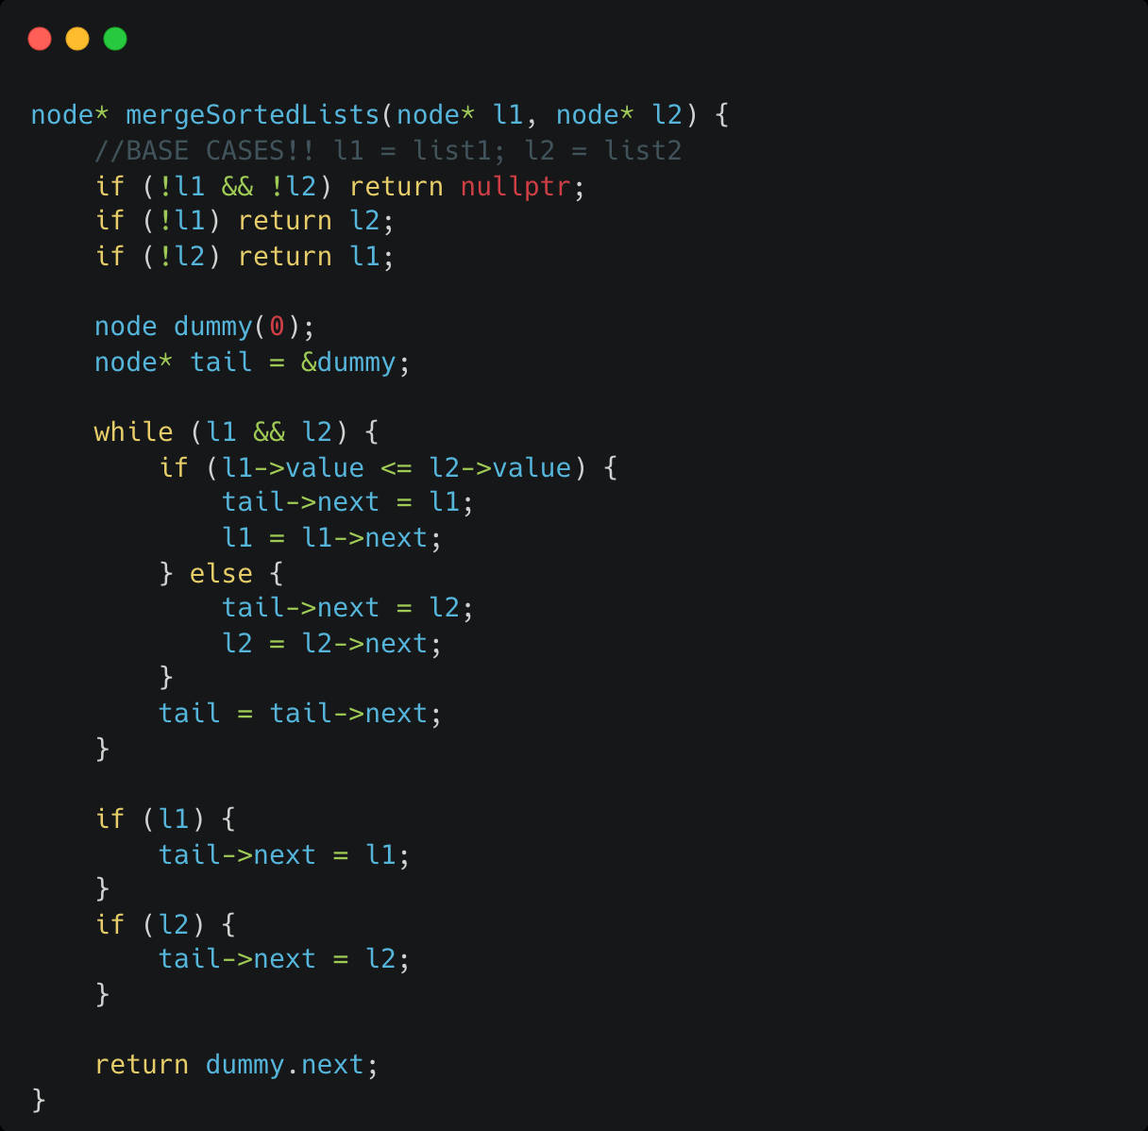
dcarril9@cougarnet.uh.edu
ykhan5@cougarnet.uh.edu

Slide 14
Problem - sumEverySecondFact()
Write a recursive function which returns the sum of factorials at every 2nd index. You have access to the factorial(int n) function.
sumEverySecondFact(4, 1)
Indexes: [1, 2, 3, 4]
Pick every 2nd index: 2 + 24 = 26
Final Output: 26
void sumEverysecondFactorial(int n, int index){}
dcarril9@cougarnet.uh.edu
ykhan5@cougarnet.uh.edu

Slide 15
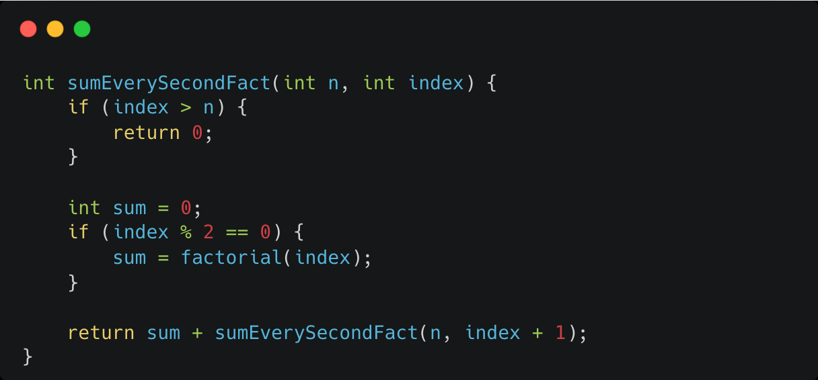
Notice how we keep track of something alongside the focus of the question (index)
dcarril9@cougarnet.uh.edu
ykhan5@cougarnet.uh.edu

Slide 16
Problem - Recursion Tracing
What is the output of func(4)?
void func(int n){
if(n >= 1){
func(n - 1);
n--;
func(n - 1);
cout << n << " ";
}
}
dcarril9@cougarnet.uh.edu
ykhan5@cougarnet.uh.edu

Slide 17
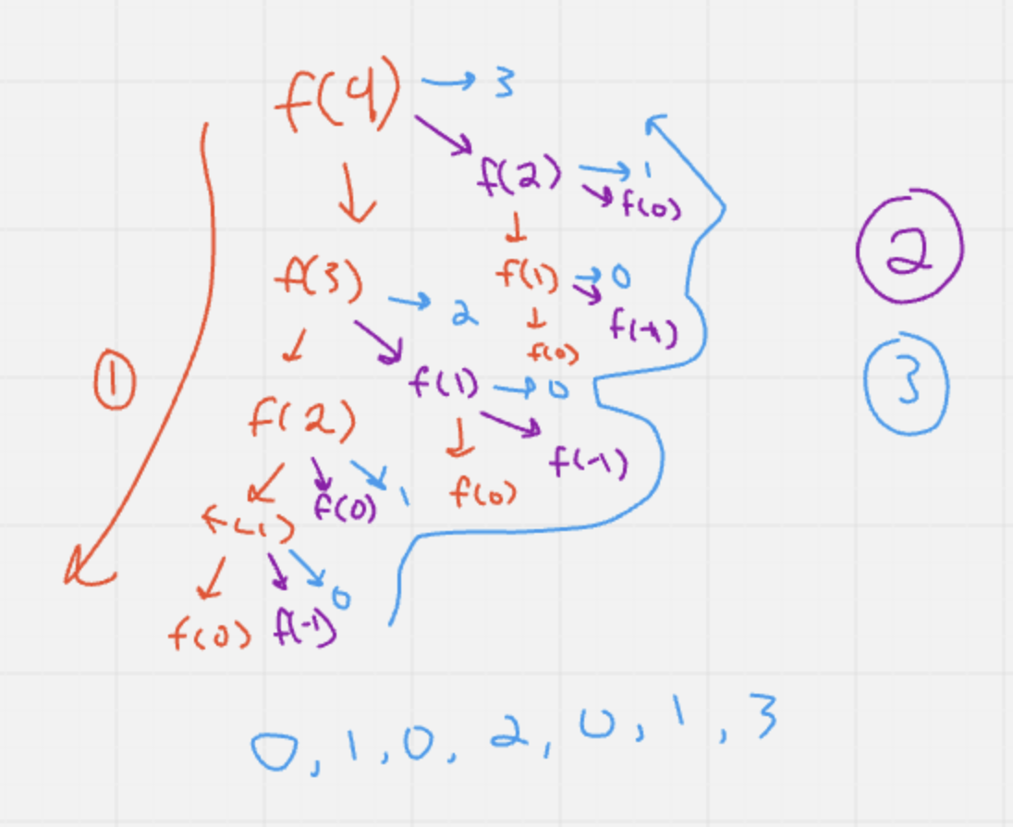
Follow the red text down, then the magenta is the second step, blue is output.
Notice how the first to finish will be the deepest, and how the above functions will have the same iterations as the ones completed, allowing you to get the output without thinking too much
I’ll explain in class.
dcarril9@cougarnet.uh.edu
ykhan5@cougarnet.uh.edu

Slide 18
Problem - Sorting Tracing
Perform bubble and insertion sort on the following array, show each step.
{2, 5, 9, 11, 7, 4}
dcarril9@cougarnet.uh.edu
ykhan5@cougarnet.uh.edu

Slide 19
{2, 5, 9, 11, 7, 4}
Pass 1: {2, 5, 9, 7, 4, 11}
Pass 2: {2, 5, 7, 4, 9, 11}
Pass 3: {2, 5, 4, 7, 9, 11}
Pass 4: {2, 4, 5, 7, 9, 11}
Pass 5: {2, 4, 5, 7, 9, 11}
dcarril9@cougarnet.uh.edu
ykhan5@cougarnet.uh.edu

Slide 20
Problem - Sorting Tracing
Perform bubble and insertion sort on the following array, show each step.
{2, 5, 9, 11, 7, 4}
dcarril9@cougarnet.uh.edu
ykhan5@cougarnet.uh.edu

Slide 21
{2, 5, 9, 11, 7, 4}
Pass 1: {2, 5, 9, 11, 7, 4}
Pass 2: {2, 5, 9, 11, 7, 4}
Pass 3: {2, 5, 9, 11, 7, 4}
Pass 4: {2, 5, 7, 9, 11, 4}
Pass 5: {2, 4, 5, 7, 9, 11}
dcarril9@cougarnet.uh.edu
ykhan5@cougarnet.uh.edu

Slide 22
Problem - Arrays
How do you initialize a Dynamic 2D array? Show code snippet.
How would you fill said array? Show code snippet and explain.
dcarril9@cougarnet.uh.edu
ykhan5@cougarnet.uh.edu

Slide 23
Problem - Time Complexity
1. What is the time complexity of the following code? What makes it that way?
for(int i = 1; i < n; ++i){
for(int j = 10; j < n; j *= 2){
cout << “Easy Points!” << endl;
}
}
dcarril9@cougarnet.uh.edu
ykhan5@cougarnet.uh.edu

Slide 24
Problem - Time Complexity
1. What is the time complexity of the following code? What makes it that way?
for(int i = 1; i < n; ++i){
for(int j = 10; j < n; j *= 2){
cout << “Easy Points!” << endl;
}
}
Solution is O(n*logn)
Remember to pay close attention to how the numbers change when approaching the stopping case.
dcarril9@cougarnet.uh.edu
ykhan5@cougarnet.uh.edu

Slide 25
Problem - Time Complexity
2. What is the time complexity of the following code?
void func(int n){
if(n < 0)
return;
else{
func(n-2);
int j = n * 2;
cout << n;
func(n-3);
}
dcarril9@cougarnet.uh.edu
ykhan5@cougarnet.uh.edu

Slide 26
Problem - Time Complexity
2. What is the time complexity of the following code?
void func(int n){
if(n < 0)
return;
else{
func(n-2);
int j = n * 2;
cout << n;
func(n-3);
}
Solution is 2^n
Remember trick is # of functions to the n power in this case.
dcarril9@cougarnet.uh.edu
ykhan5@cougarnet.uh.edu

